Slide 1
OMILIA - The Sign Language Converter
Ajay Bhat 3rd year CSE SSNCE
Avinash Raja S 3rd year CSE SSNCE
Christina Eunice John 3rd year CSE SSNCE
Kaladharshini K 3rd year CSE SSNCE
Karthika Menon 3rd year CSE SSNCE
Dr. S. Saraswathi B.E. M.E. Ph.D CSE dept. SSNCE
Dr. K. Madheswari B.E.(C.S.E.), M.E.(S.E.), Ph.D CSE dept. SSNCE
Dr. Y.V. Lokeswari M.E.(C.S.E.) B.E., M.E., Ph.D CSE dept. SSNCE

Slide 2
Outline of the presentation and Introduction
Introduction
Literature Survey
Model
Implementation
Software component
Hardware component
Outcomes
Scope
References
Omilia - The Sign Language Converter is a model which converts sign language to speech
This model mainly focuses on hand shapes for recognising sign language
This model also has a special feature of working for Indian Sign Language

Slide 3
Literature Survey
Sensor based models use BSNs^{[1]}, Leap motion and kinect^{[2]}, sensory gloves^{[3]} and DG5-VHand data gloves^{[4]}
Image processing approaches use models like MLRF^{[5]}, SVM^{[6]}, CNN^{[7]}, HMM^{[8]}, KNN^{[9]} and so on
They have varying accuracies for various datasets

Slide 4
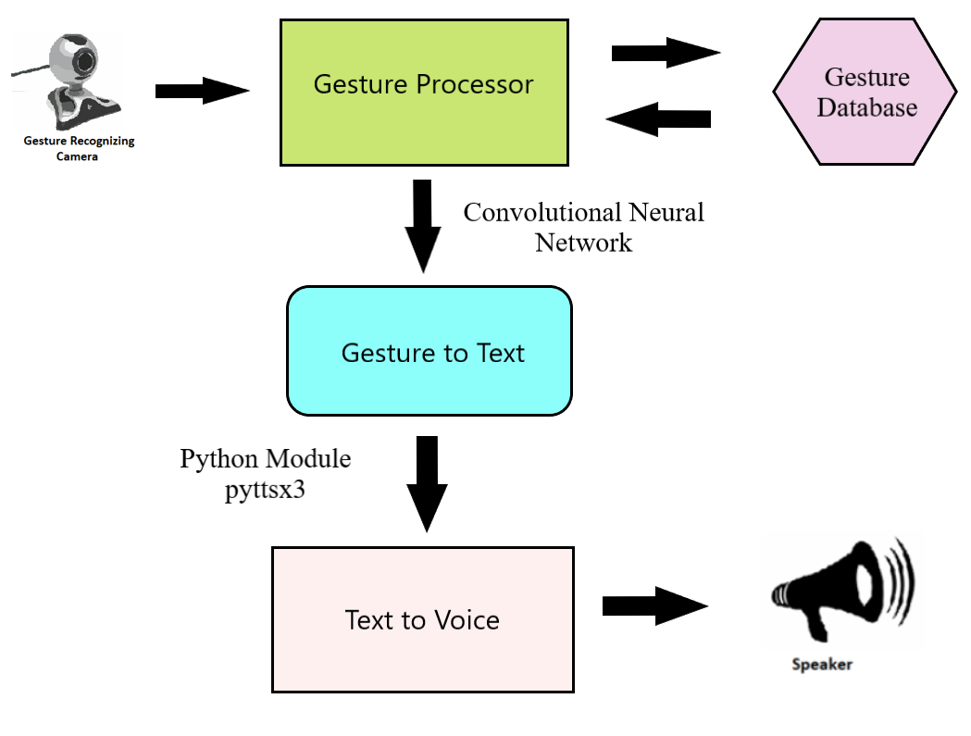
Model

Slide 5
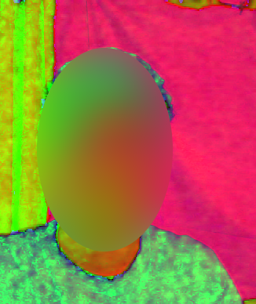
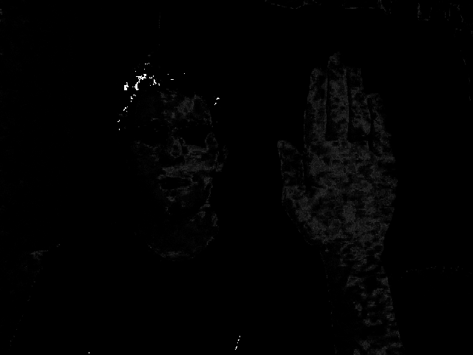
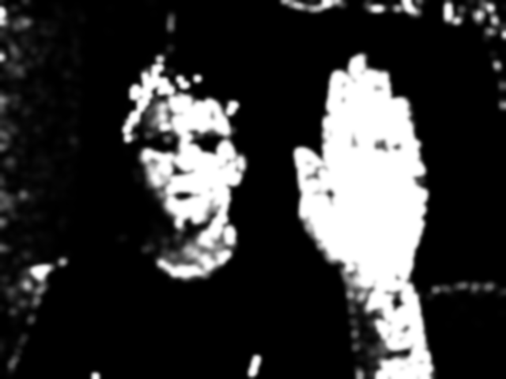

Software Implementation
HSV Image
Normalized + CalcBack
Gaussian Blur
Median Blur

Slide 6
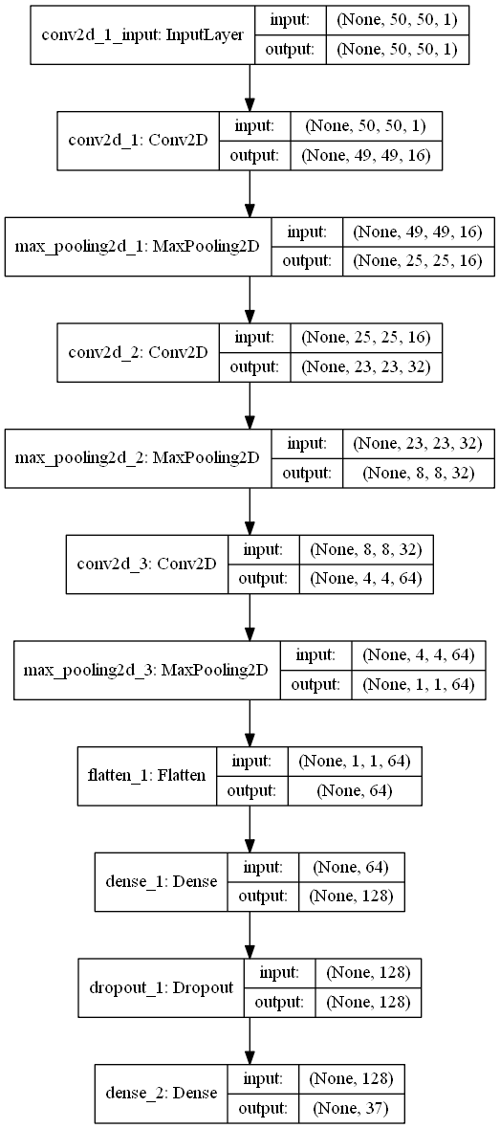
CNN Model

Slide 7
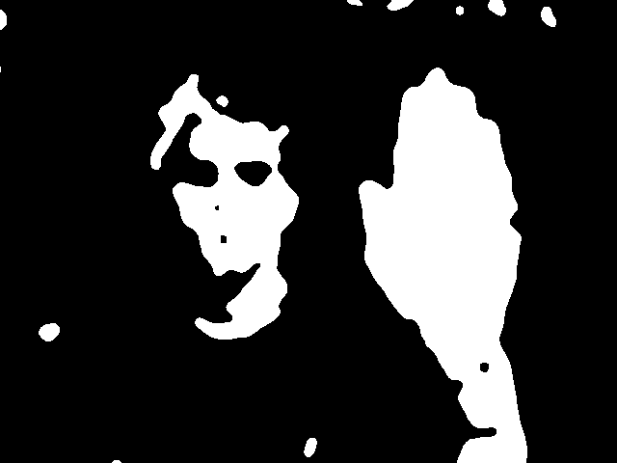
Display and Hyperparameters of the model
Hyperparameters | Values
Learning Rate | 0.01
Loss Function | Categorical Cross Entropy
Batch Size | 500
Optimizer | Stochastic Gradient Descent
Number of Epochs | 20
Steps per Epoch | 180
Thresh for setting hand histogram

Slide 8

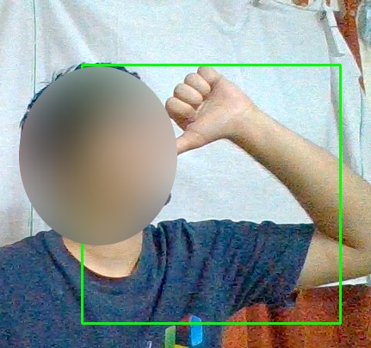
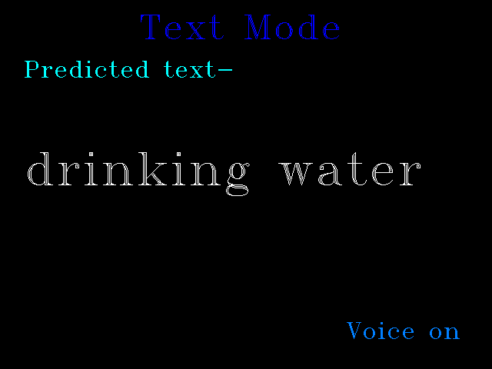
Output Display
Live-Action Window
Thresh for Live-Action Window
Prediction Board

Slide 9
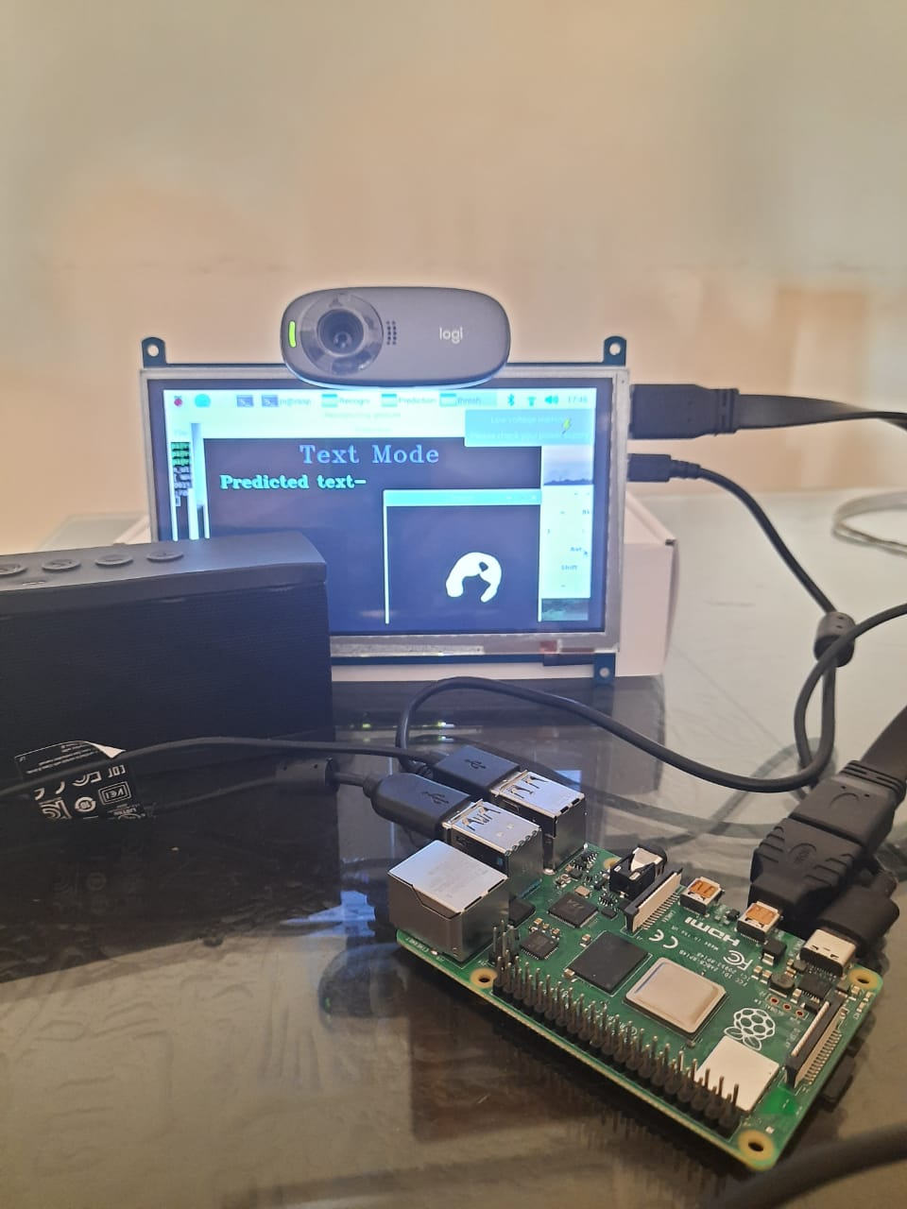
Hardware Implementation
Raspberry pi 4B 4GB RAM
Logitech C310 HD webcam
Waveshare HDMI 7 inch LCD screen
Bluetooth Speakers

Slide 10
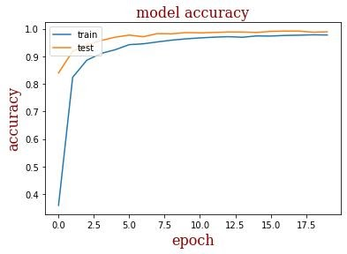
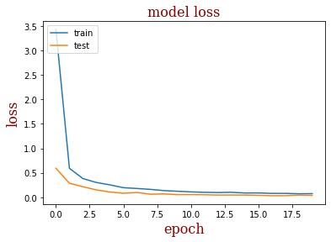
Outcomes
Omilia uses a customized 11-layer CNN model which has an accuracy of over 98%
Omilia has high precision and recall, hence low misclassification
Omilia can classify over 20 words as of now

Slide 11
Scope
This model can be extended to include dynamic hand gestures
The ISL database can be expanded to include other regional languages
The model used can be extended to be an app
The model with a good RAM can be implemented in schools

Slide 12
References
Vutinuntakasame S., Jaijongrak V.R., Thiemjarus S. An assistive body sensor network glove for speech\-and hearing\-impaired disabilities; Proceedings of the 2011 International Conference on Body Sensor Networks (BSN); Dallas, TX, USA. 23–25 May2011; pp. 7–12.
G. Marin, F. Dominio and P. Zanuttigh, "Hand gesture recognition with leap motion and Kinect devices", Proc. IEEE Int. Conf. Image Process. (ICIP), pp. 1565\-1569, Oct. 2014.
Elmahgiubi, Mohammed \& Ennajar, Mohamed \& Drawil, Nabil \& Elbuni, Mohamed. (2015). Sign Language Translator and Gesture Recognition. 10.1109/GSCIT.2015.7353332.
N. Tubaiz, T. Shanableh and K. Assaleh, "Glove\-Based Continuous Arabic Sign Language Recognition in User\-Dependent Mode," in IEEE Transactions on Human\-Machine Systems, vol. 45, no. 4, pp. 526\-533, Aug. 2015, doi: 10.1109/THMS.2015.2406692.
A. Kuznetsova, L. Leal\-Taixé and B. Rosenhahn, "Real\-Time Sign Language Recognition Using a Consumer Depth Camera," 2013 IEEE International Conference on Computer Vision Workshops, Sydney, NSW, Australia, 2013, pp. 83\-90, doi: 10.1109/ICCVW.2013.18.
Tharwat, Alaa \& Gaber, Tarek \& Hassanien, Aboul Ella \& Shahin, Mohamed \& Refaat, Basma. (2014). SIFT\-based Arabic Sign Language Recognition System. Advances in Intelligent Systems and Computing. 334. 10.1007/978\-3\-319\-13572\-4_30.
Pigou, L., Dieleman, S., Kindermans, P.J., \& Schrauwen, B. (2015). Sign Language Recognition Using Convolutional Neural Networks. Lecture Notes in Computer Science, 572\–578.
Cooper, Helen \& Ong, Eng\-Jon \& Pugeault, Nicolas \& Bowden, Richard. (2012). Sign Language Recognition using Sub\-Units. Journal of Machine Learning Research. 13. 2205\-2231.
Mathavan, Suresh \& Kumar, Mohan \& Angappan, Kumaresan. (2016). An Efficient Framework for Indian Sign Language Recognition Using Wavelet Transform. Circuits and Systems. 07. 1874\-1883. 10.4236/cs.2016.78162

